Slide 1
Predictive Maintenance System
for Industrial Machines
Forecasting machine failures 24 hours ahead using sensor data, machine learning, and intelligent automation.
Python
Scikit-Learn
FastAPI
n8n
Telegram
Power BI
Gemini/OpenAI
Presented by: [Amal Abdelmotamed | Aml Abdelrahman]
Notes:
Good [morning/afternoon] everyone. My graduation project is an AI-Powered Predictive Maintenance System for industrial machines. The goal is simple: predict machine failures up to 24 hours before they happen, using real sensor data and machine learning, then automatically alert the maintenance team and visualize machine health. Over the next 15 minutes I'll walk through the problem, the architecture, the models, and the automation pipeline that ties everything together.

Slide 2
THE PROBLEM
Unplanned Downtime Is Costing Factories
Industrial machines fail without warning, halting entire production lines.
Traditional maintenance is either reactive (fix after failure) or fixed-schedule (wastes resources).
Maintenance teams lack real-time visibility into machine health.
Failures are diagnosed manually — slow, and prone to human error.
There is no automated way to turn raw sensor data into an actionable alert.
02
Notes:
The core problem is downtime. Industry studies consistently show that a huge share of unplanned downtime comes from equipment failures that could have been anticipated. Most factories still rely on reactive maintenance — fixing things after they break — or fixed-interval maintenance, which wastes time and parts on machines that didn't need service yet. What's missing is a system that continuously watches sensor data and tells the team, in advance, which machine is at risk and why.

Slide 3
GOALS
Project Objectives
1
Predict Failures Early
2
Classify Failure Type
Detect failure risk up to 24 hours in advance using ML on live sensor readings.
Identify the specific failure mode — bearing, electrical, hydraulic, or motor overheat.
3
Automate the Pipeline
4
Deliver Actionable Insight
Connect data collection, prediction, and alerting with zero manual intervention.
Give technicians AI-generated recommendations and a live health dashboard.
03
Notes:
The project has four main objectives. First, predict failures early — within a 24-hour window. Second, go beyond a simple yes/no and classify exactly which type of failure is likely, so technicians know what to prepare for. Third, automate the entire pipeline from raw data to alert, removing manual steps. And fourth, make the output genuinely actionable — not just a number, but a clear recommendation and a live dashboard the team can trust.

Slide 4
HOW IT FITS TOGETHER
System Architecture
Sensors
n8n
FastAPI
AI Agent
Telegram
Google Sheets
Orchestration
ML Models
Recommendations
Power BI
Data flows left to right: raw readings become predictions, predictions become decisions, decisions become alerts and dashboards.
Data Layer Google Sheets stores live sensor readings per machine
Service Layer FastAPI hosts the trained ML models as REST endpoints
Intelligence Layer AI Agent (Gemini/OpenAI) interprets results into guidance
Delivery Layer Telegram + Power BI deliver alerts and visual KPIs
04
Notes:
Here's the full architecture. Sensor data lands in Google Sheets. n8n orchestrates the workflow, pulling that data on a schedule. FastAPI serves the two trained ML models and returns predictions. An AI agent — built on Gemini or OpenAI — interprets those predictions into human-readable maintenance recommendations. Finally, Telegram pushes real-time alerts to technicians while Power BI gives management a live dashboard of machine health and KPIs. Everything after the raw sensor reading is fully automated.

Slide 5
DATA
Dataset Description
machine_type
vibration_rms
temperature_motor
Category of the industrial machine
Root-mean-square vibration signal
Motor housing temperature (°C)
current_phase_avg
pressure_level
rpm
Average electrical phase current
Hydraulic/pneumatic pressure reading
Rotational speed of the machine
operating_mode
hours_since_maintenance
ambient_temp
Idle / Normal / Heavy-load state
Time elapsed since last service
Surrounding environmental temperature
05
Notes:
The dataset combines nine sensor and operational features per machine reading — vibration, motor temperature, current, pressure, RPM, operating mode, time since last maintenance, ambient temperature, and machine type. These were chosen because they map directly to physical failure mechanisms: vibration and RPM catch bearing issues, current catches electrical faults, pressure catches hydraulic problems, and temperature catches motor overheating.

Slide 6
PREPARING THE DATA
Data Preprocessing
1
2
3
4
Cleaning
Encoding
Scaling
Splitting
Remove duplicates, handle missing sensor readings, filter out sensor noise/outliers.
Convert categorical fields (machine_type, operating_mode) into numerical form.
Normalize numerical features (vibration, temperature, pressure) to a common range.
Divide data into training and testing sets, stratified by failure label.
Pandas performs cleaning and transformation; Scikit-Learn's preprocessing utilities handle encoding, scaling, and train/test splitting.
06
Notes:
Before training, raw sensor data goes through four preprocessing stages. First we clean it — removing duplicates, handling missing readings, and filtering sensor noise. Then we encode categorical fields like machine type and operating mode into numbers models can use. Next we scale the numerical features so no single sensor dominates just because of its unit range. Finally, we split the data into training and testing sets, keeping the failure classes balanced across both. Pandas handles the heavy lifting for cleaning, and Scikit-Learn handles encoding, scaling, and splitting.

Slide 7
THE CORE INTELLIGENCE
Machine Learning Models
MODEL 1 · Failure Prediction
MODEL 2 · Failure Type Classification
Binary classifier trained on labeled sensor windows to flag imminent risk.
Multi-class classifier that pinpoints the likely failure mode when risk is flagged.
0
Normal — machine operating within safe limits
Bearing Failure
Electrical Failure
1
Failure Risk — intervention needed within 24h
Hydraulic Failure
Motor Overheat
Algorithms evaluated: Random Forest, Gradient Boosting, Logistic Regression (baseline).
Algorithm: Random Forest (multi-class), chosen for interpretability and robustness on tabular sensor data.
08
Notes:
There are two models working together. The first is a binary Failure Prediction model — it outputs 0 for normal operation or 1 for failure risk within the next 24 hours. We evaluated Random Forest, Gradient Boosting, and Logistic Regression as a baseline. The second model only runs when risk is flagged: it's a multi-class Failure Type Classifier that identifies whether it's a bearing, electrical, hydraulic, or motor overheating issue — or none. We used Random Forest here for its strong performance and interpretability on tabular sensor data.

Slide 8
HOW WE MEASURED SUCCESS
Model Evaluation Metrics
EVALUATION APPROACH
Stratified k-fold cross-validation to handle class imbalance.
Confusion matrix reviewed per failure type.
Recall prioritized over precision — missing a real failure is costlier than a false alarm.
Metrics tracked on a held-out test set, unseen during training.
09
Notes:
Both models were evaluated using accuracy, precision, recall, and F1-score on a held-out test set, with stratified k-fold cross-validation to handle the natural imbalance between normal and failure cases. The Failure Prediction model reached about 94% accuracy with 88% recall, and the Failure Type Classifier reached about 91% accuracy. We deliberately prioritized recall over precision, because in this domain a missed real failure is far more costly than an occasional false alarm.

Slide 9
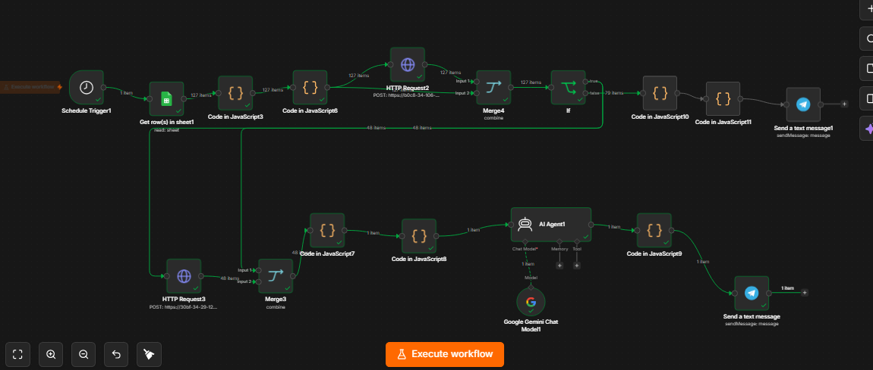
ORCHESTRATION
n8n Automation Workflow
11
Notes:
n8n is the orchestration layer that ties everything together. On a schedule, it reads the latest sensor rows from Google Sheets, calls the FastAPI prediction endpoint, and routes the result: if risk is detected, it triggers the AI agent for a recommendation and fires off Telegram and Power BI updates; if not, it simply logs the normal reading. We chose n8n because it's visual and no-code, has native integrations for every service we use, and cleanly decouples automation logic from the ML service.

Slide 10
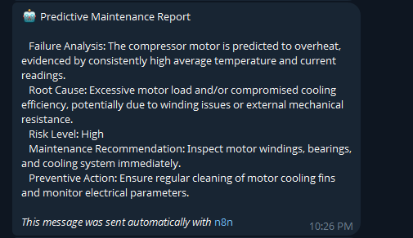
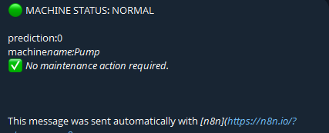
Response telegram

Slide 11
FROM PREDICTION TO GUIDANCE
AI Agent Integration
INPUT
AI
OUTPUT
Machine ID & type
Failure prediction (1)
Predicted failure type
Recent sensor trend
Plain-language explanation of the risk
Likely root cause reasoning
Recommended maintenance action
Urgency level (Low / Medium / High)
Gemini / OpenAI
Agent
Reasons over structured model output using a domain-specific prompt and machine context.
12
Notes:
Once the ML models produce a prediction, that structured output — machine ID, risk flag, failure type, sensor trend — is passed to an AI agent built on Gemini or OpenAI. The agent doesn't replace the ML models; it interprets their output using a domain-specific prompt and the machine's context, turning raw numbers into a plain-language explanation, a likely root cause, a concrete recommended action, and an urgency level. This is what makes the alert genuinely useful to a technician rather than just a number.

Slide 12
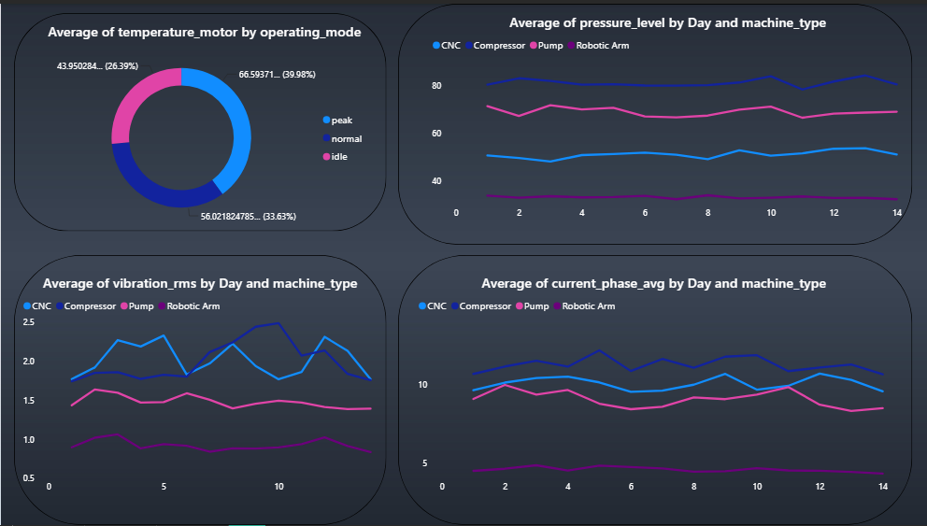
VISUALIZING MACHINE HEALTH
Power BI Dashboard
14
Notes:
Power BI ties the whole system together for management. It shows live KPIs — machines monitored, active risk alerts, overall prediction accuracy, and average time-to-alert. Below that, trend charts let you drill into a specific machine's vibration history, and a breakdown of failure types over the last month helps the team spot recurring problems, like a bearing issue that keeps showing up across the fleet.

Slide 13
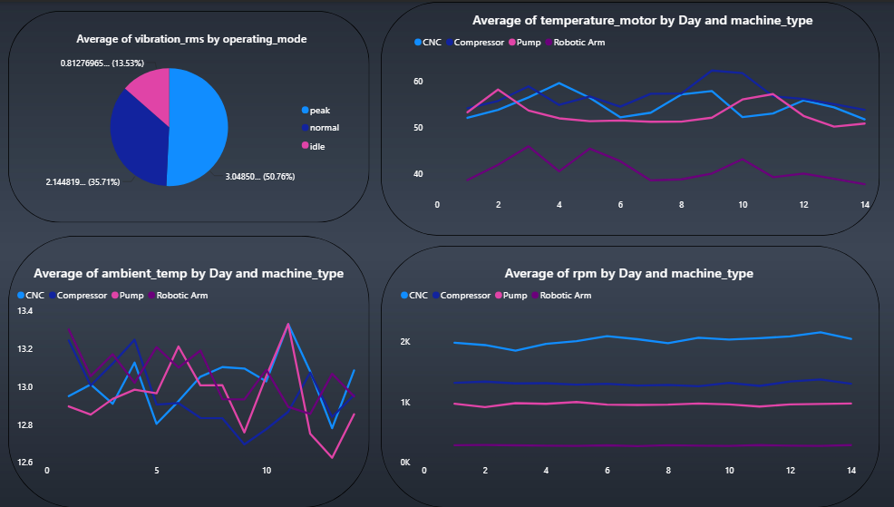

Slide 14
CONCLUSION
From Raw Sensor Data
to Automated Action
Built an end-to-end predictive maintenance pipeline — from sensor data to a technician's phone.
Two ML models work together to predict both failure risk and failure type with strong accuracy.
n8n, FastAPI, and an AI agent fully automate the path from prediction to actionable recommendation.
Power BI and Telegram close the loop, giving both real-time alerts and long-term visibility.
The result: a practical shift from reactive repairs to proactive, data-driven maintenance.
Thank you — questions welcome.
Notes:
To conclude: this project shows that a predictive maintenance system doesn't need to be a black box locked away in a data science notebook. By combining two well-scoped ML models with FastAPI, n8n, an AI agent, Telegram, and Power BI, we built a complete pipeline that takes raw sensor readings and turns them into a specific, actionable alert on a technician's phone within minutes — shifting maintenance from reactive to proactive. Thank you, and I'm happy to take any questions.

